Slide 1
大作文-同意与否

Slide 2
同不同意
讨论类Argumentation
讨论两个观点
讨论利弊
大作文题型
报告类
Report
综合类
Combination

Slide 3
学习要点
1.同意与否类议论文题目特征-常见陷阱
2.同意与否（偏向不同意）：文章结构+范文解析
3.同意与否（彻底不同意）：文章结构+范文解析
4.同意与否（偏向同意）：文章结构+范文解析
5.同意与否（彻底同意）：文章结构+范文解析

Slide 4
学习要点
1.同意与否类议论文题目特征-常见陷阱
2.同意与否（偏向不同意）：文章结构+范文解析
3.同意与否（彻底不同意）：文章结构+范文解析
4.同意与否（偏向同意）：文章结构+范文解析
5.同意与否（彻底同意）：文章结构+范文解析

Slide 5
如何审题：常见陷阱

Slide 6
常见“陷阱”1
When choosing a job, the salary is the most important consideration. To what extent do you agree or disagree?
The best way to reduce crimes by young people is to educate their parents with parental skills. To what extent you agree or disagree？
The spread of multinational companies and the resulting increase in globalization produce positive effects to everyone. Do you agree or disagree with this statement?

Slide 7
常见“陷阱”1: 绝对词
When choosing a job, the salary is the most important consideration. To what extent do you agree or disagree?
The best way to reduce crimes by young people is to educate their parents with parental skills. To what extent you agree or disagree？
The spread of multinational companies and the resulting increase in globalization produce positive effects to everyone. Do you agree or disagree with this statement?

Slide 8
常见“陷阱”2
Some people think reading stories in books is better than watching TV or playing computer games for children.
To what extent do you agree or disagree?

Slide 9
常见“陷阱”2：必须对比
Some people think reading stories in books is better than watching TV or playing computer games for children.
To what extent do you agree or disagree?
A更好 vs. B更好

Slide 10
常见“陷阱”3
Nowadays, there is a large amount of advertising aimed at children. Some people think this has negative effects on children and should be banned.To what extent do you agree or disagree?
Traditional foods are being replaced by international fast foods. This has a negative effect on families and society.
To what extent do you agree or disagree?

Slide 11
常见“陷阱”3-and并列（前后均需回应）
Nowadays, there is a large amount of advertising aimed at children. Some people think this has negative effects on children and should be banned.
To what extent do you agree or disagree?
Traditional foods are being replaced by international fast foods. This has a negative effect on families and society.
To what extent do you agree or disagree?

Slide 12
常见“陷阱”
绝对词 | best/most/only/everyone
比较 | instead of/rather than/better
并列项 | and

Slide 13
学习要点
1.同意与否类议论文题目特征-常见陷阱
2.同意与否（偏向不同意）：文章结构+范文解析
3.同意与否（彻底不同意）：文章结构+范文解析
4.同意与否（偏向同意）：文章结构+范文解析
5.同意与否（彻底同意）：文章结构+范文解析

Slide 14
同意与否：偏向不同意

Slide 15
《第八代强化版》P17/107
Convenience foods will become increasingly prevalent and eventually replace traditional foods and traditonal mehtods of food preparation.
To what extent do you agree or disagree with this opinion?

Slide 16
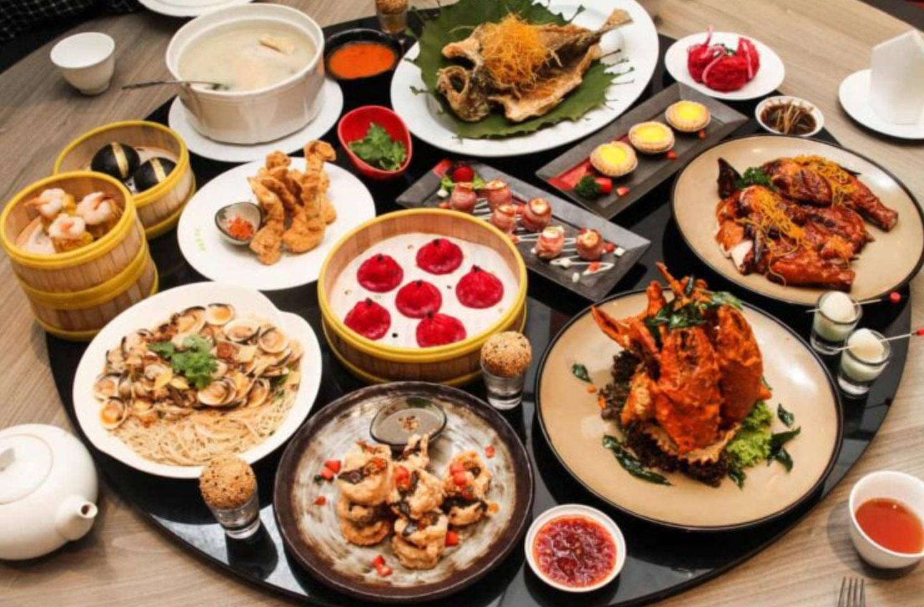
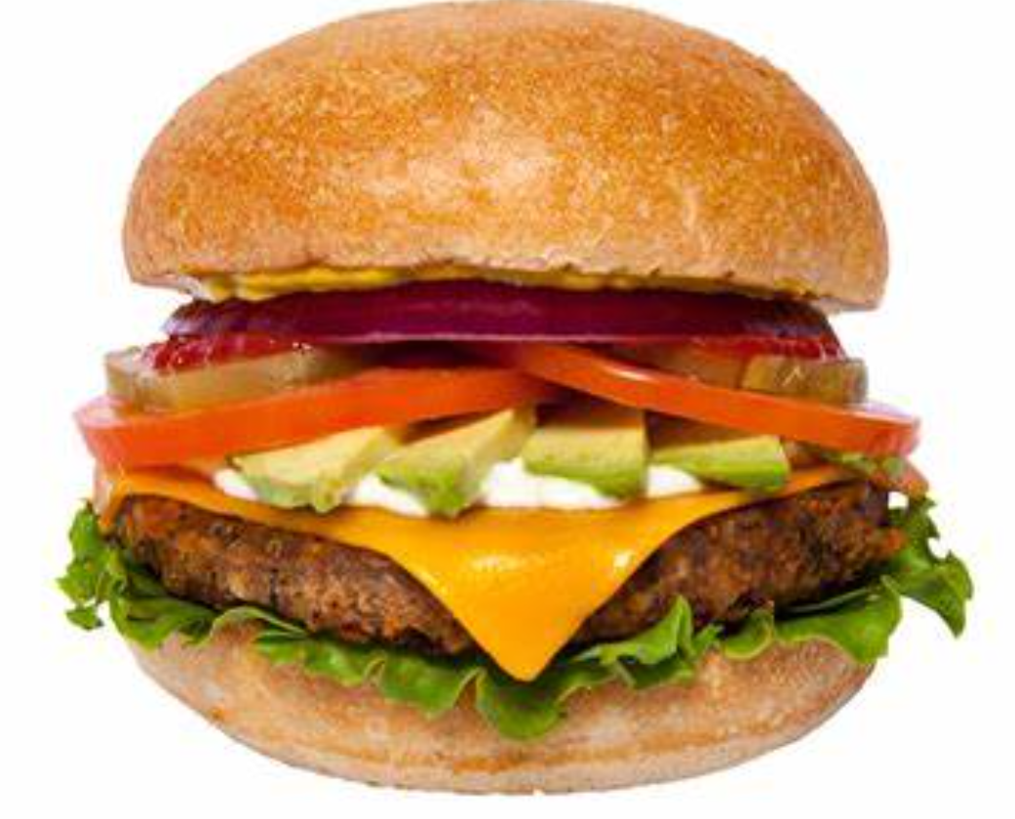
《第八代强化版》P17/107
Convenience foods will become increasingly prevalent and eventually replace traditional foods and traditonal mehtods of food preparation.
To what extent do you agree or disagree with this opinion?

Slide 17
讨论类-同不同意（偏向不同意）
让步段Para2:
有“需求”
反驳段Para3/Para4:
但是不会取代“传统食物”

Slide 18
让步段Para2:
It is true that...
There is no denying that...
It is true that nowadays many people do not have enough time to cook and that convenience foods present an attractive option.These foods have improved significantly in terms of quality and availability and the range for sale in the average supermarket is quite impressive.It is possible to find even very sophisticated ready-prepared microwavable meals.

Slide 19
反驳段Para3:
However,...
Nevertheless,..
However,the growing popularity of television cookery programmes, 'celebrity chefs',and cook books suggest that people continue to value traditional ways of preparing foods. Farmers markets selling fresh, locally-produced food continue to be the norm in many parts of the world.In fact, they are growing inpopularity in countries such as the UK, where they had virtually disappeared from many cities.This may be partly because cooking with basic,natural ingredients is cheaper than buying processed foods.

Slide 20
反驳段Para4:
Moreover, ...
In spite of..., I would argue that...
Moreover, traditional foods are an important aspect of culture and social life.In many countries, traditional meals continue to be shared in regular family gatherings. Important celebrations such as weddings,Christmas and Chinese New Year are marked by traditionally prepared feasts.

Slide 21
学习要点
1.同意与否类议论文题目特征-常见陷阱
2.同意与否（偏向不同意）：文章结构+范文解析
3.同意与否（彻底不同意）：文章结构+范文解析
4.同意与否（偏向同意）：文章结构+范文解析
5.同意与否（彻底同意）：文章结构+范文解析

Slide 22
同意与否：彻底不同意

Slide 23
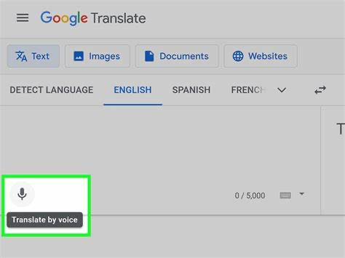
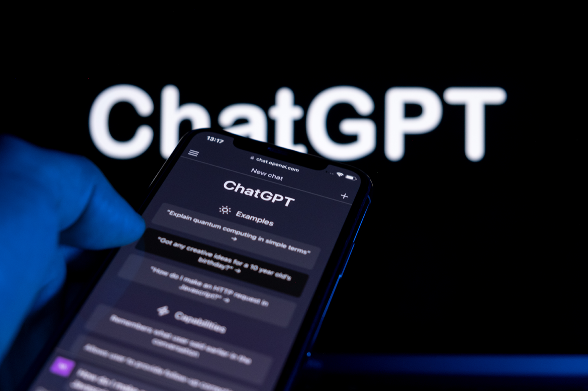
Some people say that computers can translate all languages well. Therefore, children do not need to learn foreign languages any more. Do you agree or disagree with this view?

Slide 24
Some people say that computers can translate all languages well. Therefore, children do not need to learn foreign languages any more. Do you agree or disagree with this view?

Slide 25
Intro
B1
B2
Con
completely disagree
It is quite debatable that…
驳因
all languages can be precisely/ accurately translated by computers.
Another factor is that…
驳果
it is of great necessity and importance for young generations to study foreign languages.
completely disagree

Slide 26
学习要点
1.同意与否类议论文题目特征-常见陷阱
2.同意与否（偏向不同意）：文章结构+范文解析
3.同意与否（彻底不同意）：文章结构+范文解析
4.同意与否（偏向同意）：文章结构+范文解析
5.同意与否（彻底同意）：文章结构+范文解析

Slide 27
同意与否：偏向同意

Slide 28
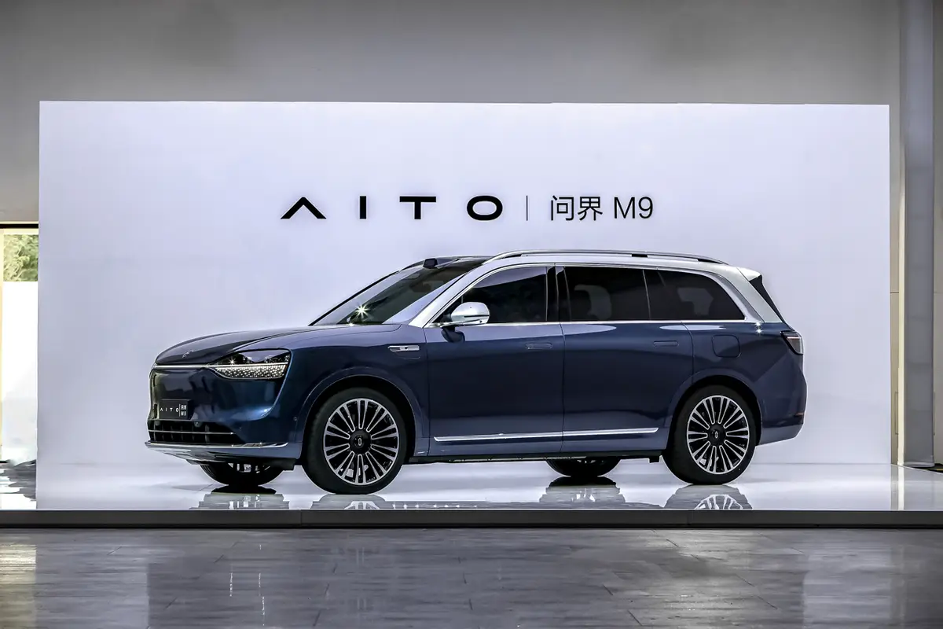
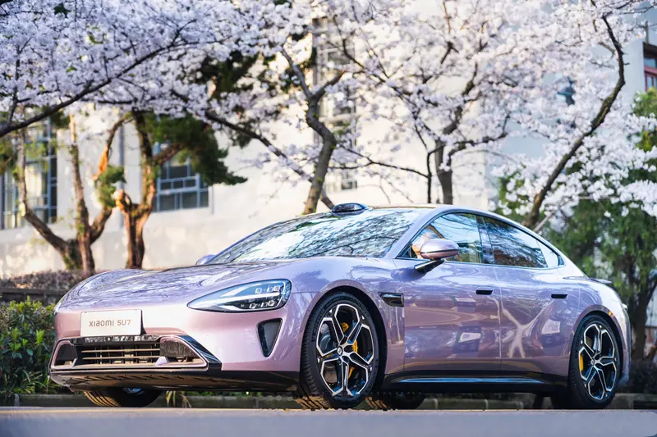
It will be better to have wide use of driverless cars for individuals and society. To what extent do you agree or disagree? (20210904)

Slide 29
It will be better to have wide use of driverless cars for individuals and society. To what extent do you agree or disagree? (20210904)

Slide 30
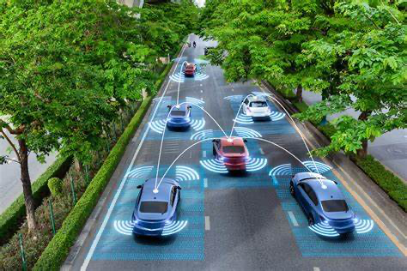
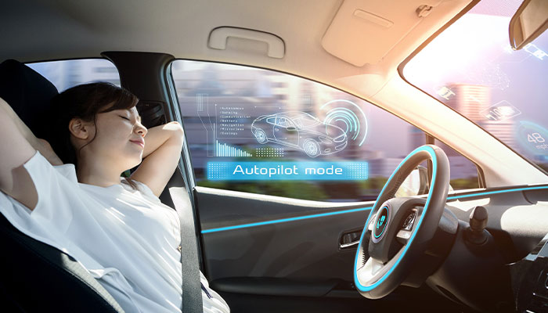
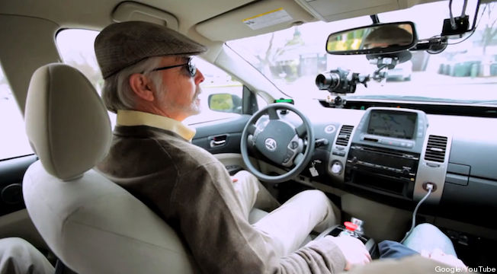
benefits (individuals)
Increased convenience
Enhanced safety
Improved accessibility

Slide 31
benefits (individuals)
Increased convenience: Driverless cars can handle the driving tasks, allowing individuals to focus on other activities during their commute or travel time.
Enhanced safety: With technologies and sensors(传感器), driverless cars have the potential to reduce human errors and accidents, making roads safer for individuals.
Improved accessibility: Driverless cars can provide transportation options for individuals who are unable to drive due to age, disability, or other reasons, enhancing mobility and independence.

Slide 32
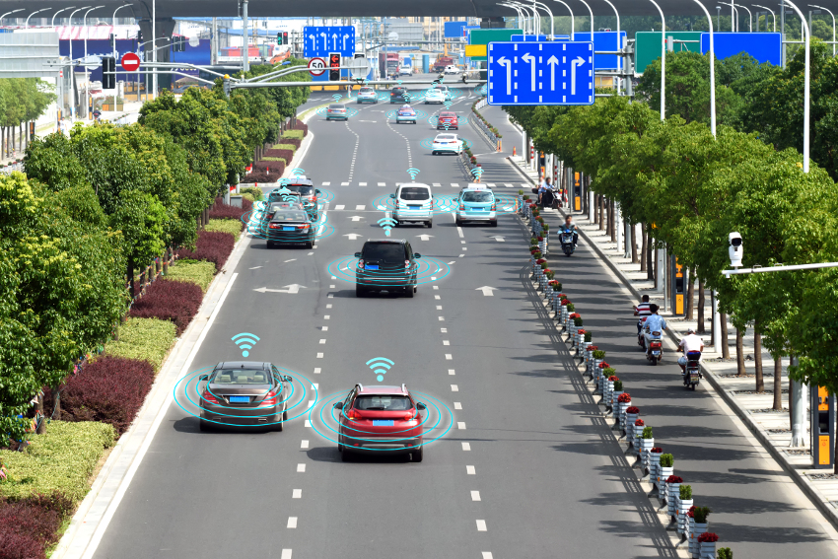
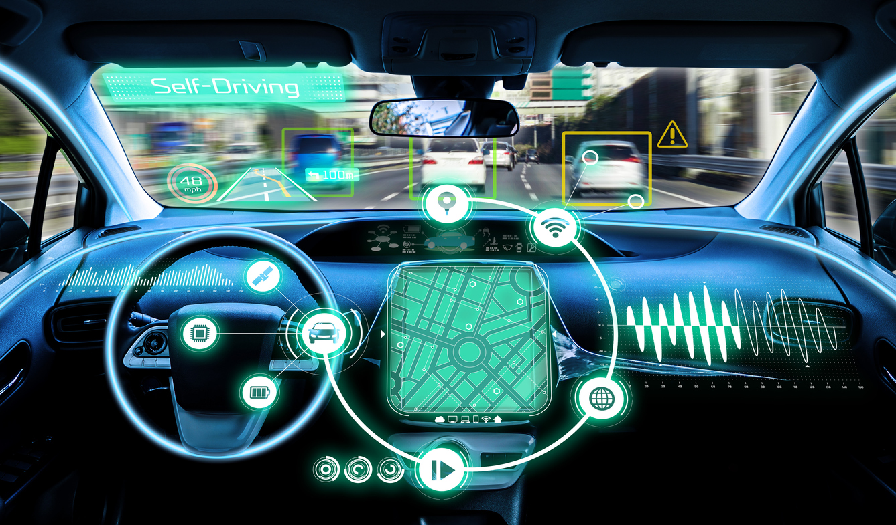
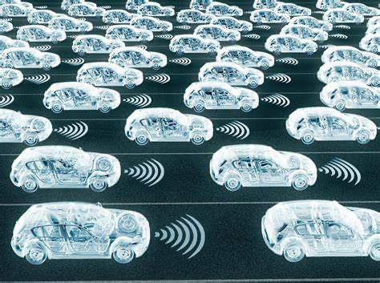
benefits (society)
Reduction in accidents and fatalities
Increased efficiency and
reduced traffic congestion
Environmental benefits

Slide 33
benefits (society)
Reduction in accidents and fatalities: Autonomous vehicles have the potential to minimize human error, which is the leading cause of accidents. This can result in a significant decrease in traffic accidents and related fatalities.
Increased efficiency and reduced traffic congestion: Autonomous cars can communicate with each other and optimize(优化) traffic flow, leading to smoother traffic patterns and reduced congestion(拥堵), which can save time and fuel.
Environmental benefits: Driverless cars have the potential to be more fuel-efficient and contribute to reduced emissions, helping to mitigate(减轻) the impact of transportation on the environment.

Slide 34
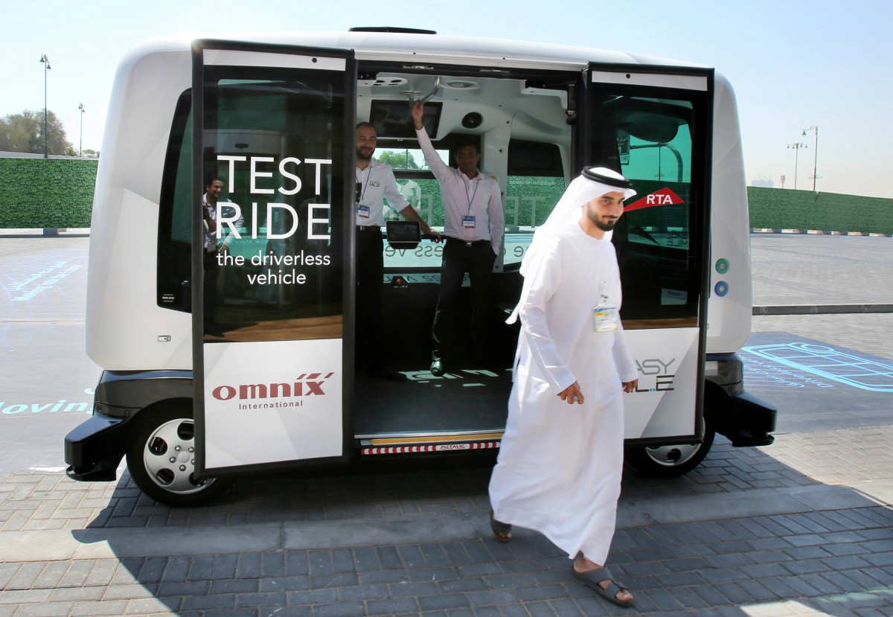
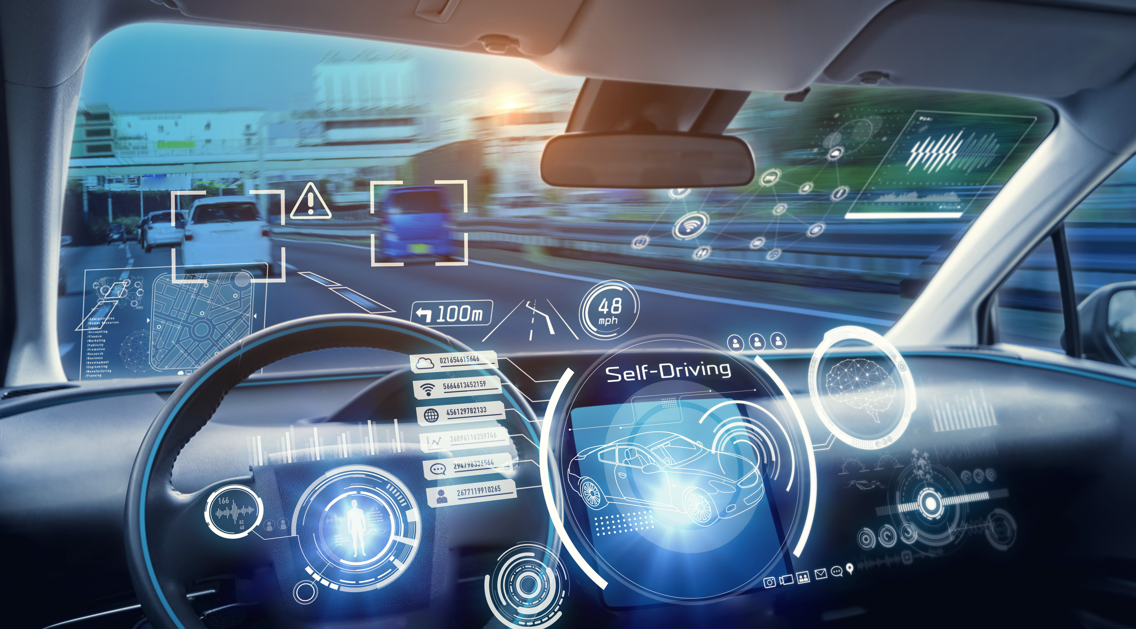
drawbacks (individuals)
Technological limitations
Initial costs

Slide 35
drawbacks (individuals)
Technological limitations: Driverless cars heavily rely on complex technology, making them susceptible(易受影响的) to malfunctions(故障), system failures, and vulnerabilities(缺陷) to cyber threats.
Initial costs: The cost of purchasing a driverless car or upgrading existing vehicles with autonomous technology may be expensive, limiting access for some individuals.

Slide 36
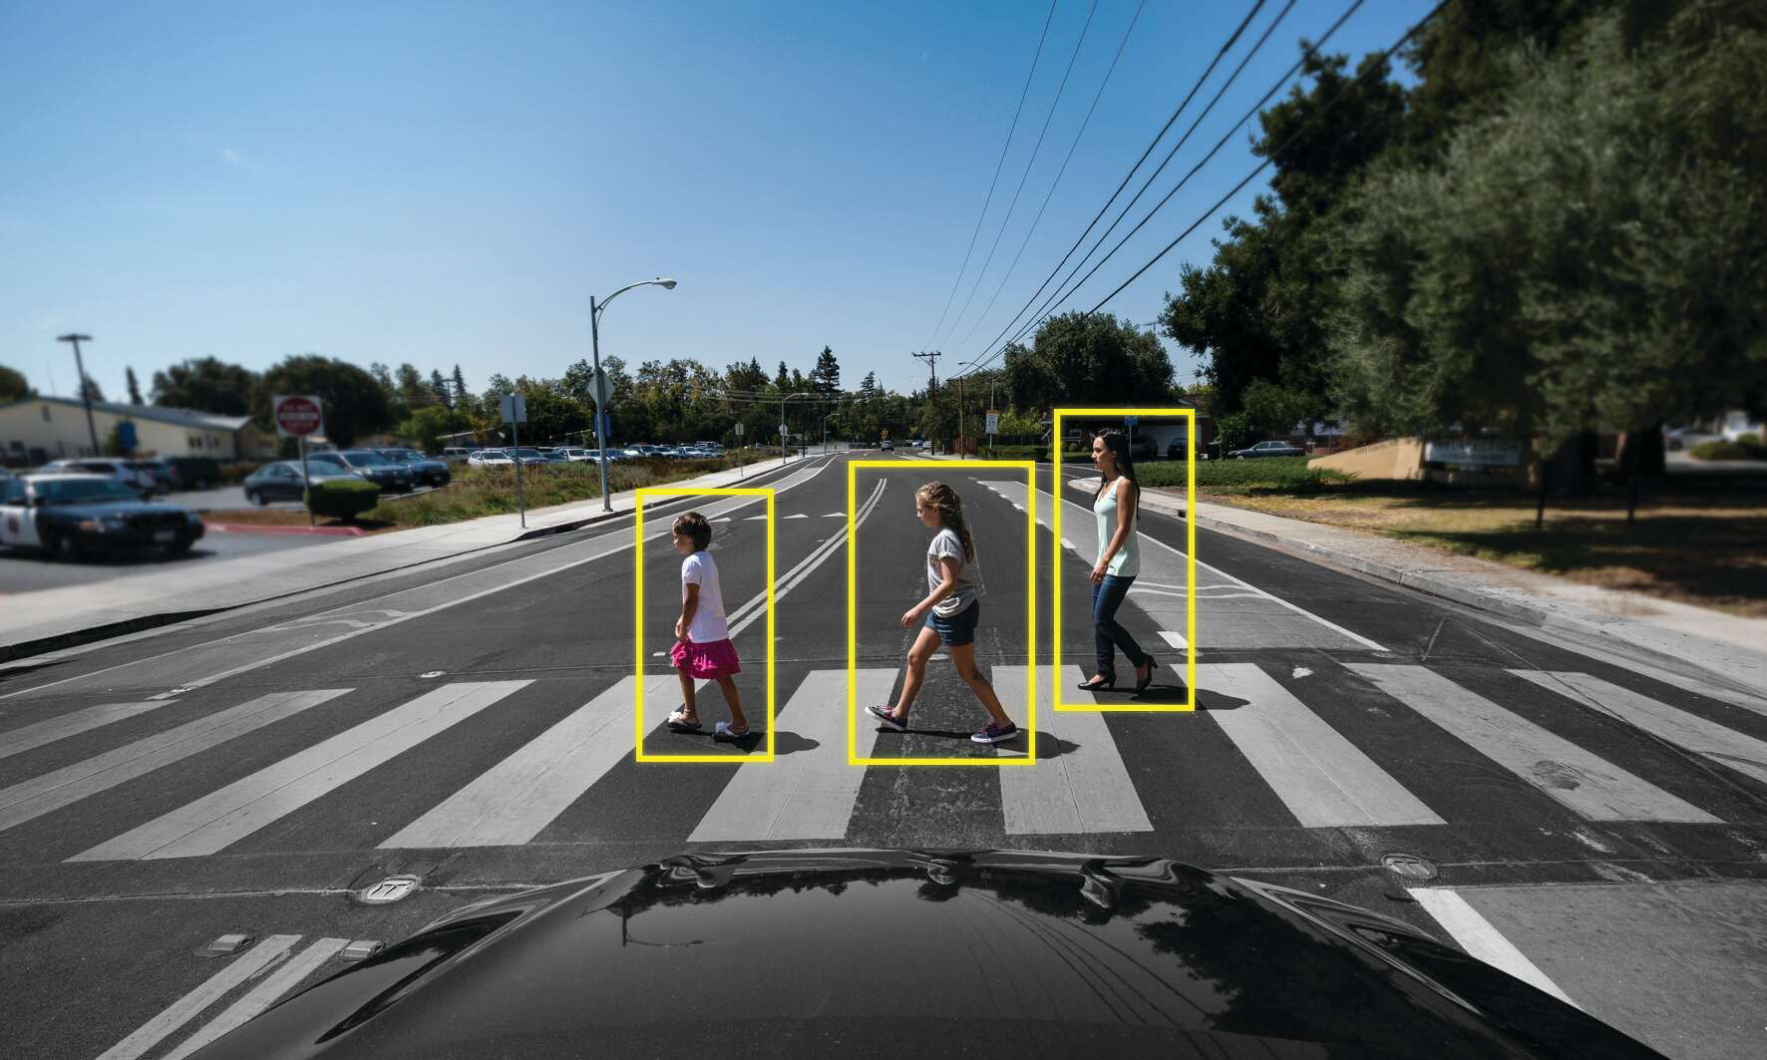
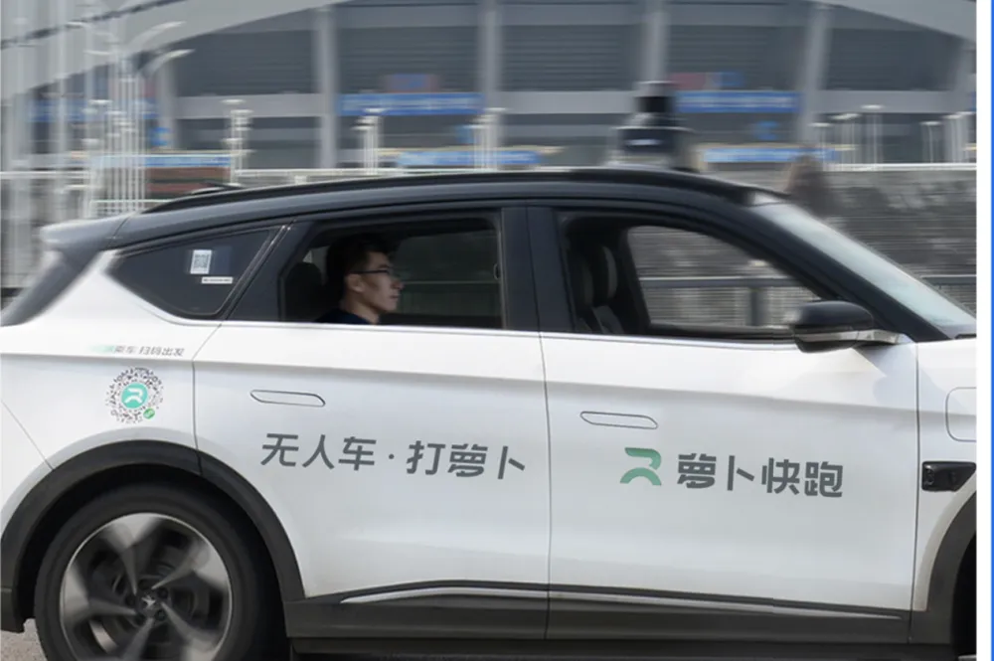
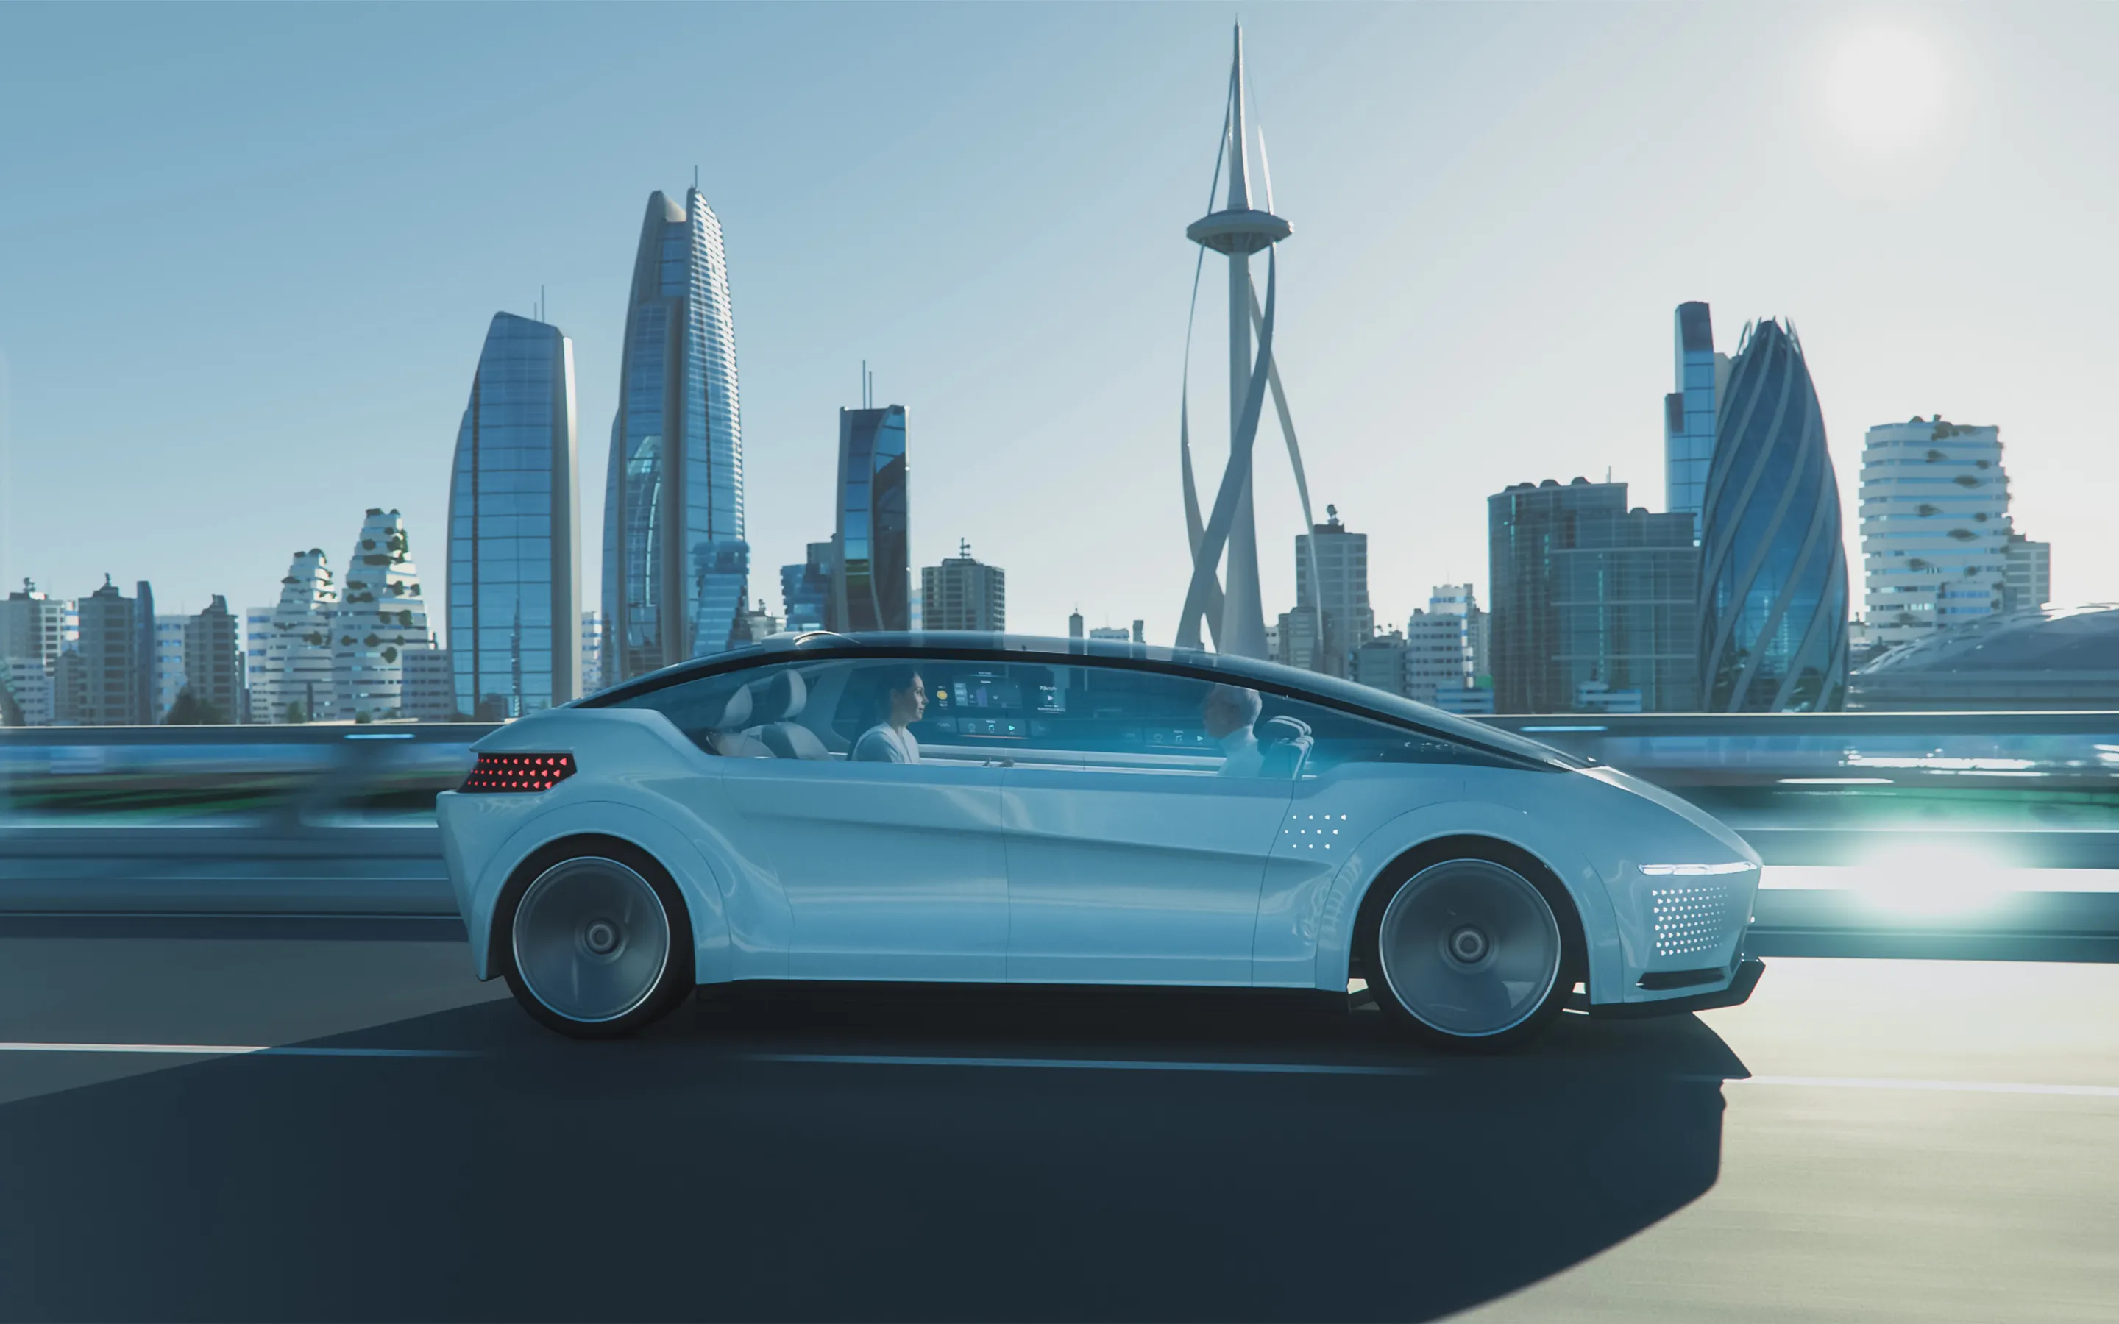
drawbacks (society)
Job displacement
Ethical and legal concerns
Infrastructure requirements

Slide 37
drawbacks (society)
Job displacement: The widespread adoption of autonomous vehicles could result in job losses for professional drivers and related industries, such as taxi and trucking services.
Ethical and legal concerns: The programming of self-driving cars to make split-second(刹那间的) decisions in potential accident scenarios(场景) raises ethical dilemmas(窘境) regarding prioritization(优先次序) of different lives and potential legal liabilities(义务).
Infrastructure requirements: The integration of autonomous vehicles into existing transportation systems would require significant infrastructural updates, such as new signage(路标), road changes, and communication infrastructure, which can be costly and time-consuming.

Slide 38
讨论类-同不同意（偏向同意）
让步段Para2:
有“缺点”
反驳段Para3:
但是整体来看对个人和社会好

Slide 39
讨论类-同不同意（偏向同意）
让步段Para2:
It is true that...
There is no denying that...
反驳段Para3:
However,...
Nevertheless,..
In spite of..., I would argue that...

Slide 40
学习要点
1.同意与否类议论文题目特征-常见陷阱
2.同意与否（偏向不同意）：文章结构+范文解析
3.同意与否（彻底不同意）：文章结构+范文解析
4.同意与否（偏向同意）：文章结构+范文解析
5.同意与否（彻底同意）：文章结构+范文解析

Slide 41
同意与否：彻底同意

Slide 42
《第八代强化版》P81/131
Many people believe that media coverage of celebrities is having a negative effect on children.
To what extent do you agree or disagree with this opinion?

Slide 43
《第八代强化版》P81/131
Many people believe that media coverage of celebrities is having a negative effect on children.
To what extent do you agree or disagree with this opinion?

Slide 44
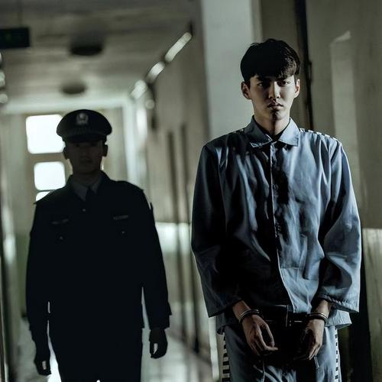
《第八代强化版》P81/131
名人新闻有哪些类别？
对孩子有哪些影响？

Slide 45
negative effects
confuse fame(名誉) and notoriety(声名狼藉)
(see misbehavior as normal)
One of the possible negative consequences of the cult(狂热) of celebrity is the tendency to confuse fame and notoriety. Celebrity scandals are just as likely to receive publicity as celebrity achievements Indeed, some famous people have received more attention for their misuse of drugs and alcohol than for their succes on the stage or in sports. Children who crave attention may come to see misbehaviour as normal.

Slide 46
negative effects
at the cost of(以..为代价) serious news coverage
(form a distorted picture of how the world works)
The emphasis on individuals in the public eye may also be at the expense of serious news coverage.Next to the superficial excitement of celebrity gossip,news about serious events and issues that have a more profound effect on people's lives may seem uninteresting.Children may be forming a very distorted picture of how the world works.

Slide 47
negative effects
children's career aspirations:
(develop unrealistic expectations)
The negative influence of celebrities on children can also be seen in children's career aspirations.These days,young people are much more likely to see themseves as potential sports stars or entertainers.The prevalence of these figures in the mass media may convey impression that such positions are plentiful.Children may be developing unrealistic expectations that they too will become rich and famous.

Slide 48
Homework
(20230708)If people go to live in another country, they should follow the local customs and traditions. To what extent do you agree or disagree?

Slide 49
THANKS

